Slide 1

SmartWarehouse Management System (WMS)
A comprehensive solution for efficient product inventory and stock movement across multiple warehouse locations.

Slide 2


PROJECT OVERVIEW
Solving the Inventory Challenge
Efficient Inventory Handling
Designed to manage product inventory and stock movement across multiple warehouse locations.
Role-Based Access
Enables administrators and employees to manage products and track stock using secure access control.

Slide 3

The Problem: Manual Tracking Pain Points
Inventory Mismatches
Discrepancies due to manual data entry in spreadsheets.
Missing Updates
Product updates are often unrecorded or delayed.
Lack of Visibility
No centralized view of stock across all warehouse locations.
Unrecorded Movements
Inbound and outbound stock changes are not consistently logged.

Slide 4

The Solution: SmartWarehouse WMS
Centralized Control
Automated Logging
Single source of truth for all inventory data.
System automatically tracks and logs all stock changes.
Secure Access
RESTful APIs
Role-based access ensures secure and appropriate operations.
Provides APIs for seamless product, stock, and warehouse management.

Slide 5


FUNCTIONAL REQUIREMENTS
Key Management APIs
Users
Warehouses
Register, Login, and retrieve lists of all system users.
CRUD operations (Create, Read, Update, Delete) for warehouse records.
Products
Stocks & Orders
CRUD operations, plus filtering by category and price range.
Restock (INBOUND), Send Order (OUTBOUND), and check total stock.

Slide 6



NON-FUNCTIONAL REQUIREMENTS
System Quality and Reliability
2s
24/7
100%
Performance
Availability
Logging
Real-time stock updates must occur in under 2 seconds.
The REST API must be accessible 24 hours a day, 7 days a week.
All stock activities are recorded in the InventoryLog for auditability.
Security is maintained via JWT-based authentication and role-based authorization, supporting scalability across multiple independent warehouses.

Slide 7
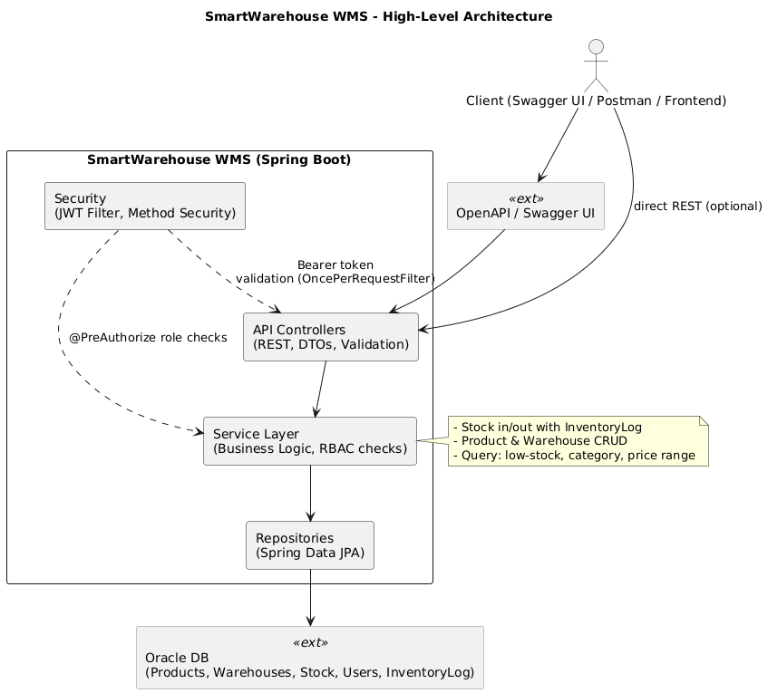
System Architecture: High-Level Diagram
The diagram illustrates the core components and data flow, showing the interaction between the API Gateway, Microservices, and Database.

Slide 8
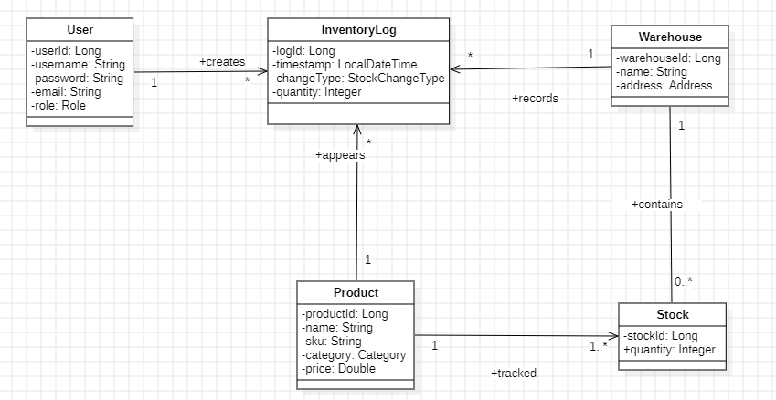
Core Data Model: Class Diagram
This view details the relationships between key entities: User, Warehouse, Product, Stock, and InventoryLog.

Slide 9
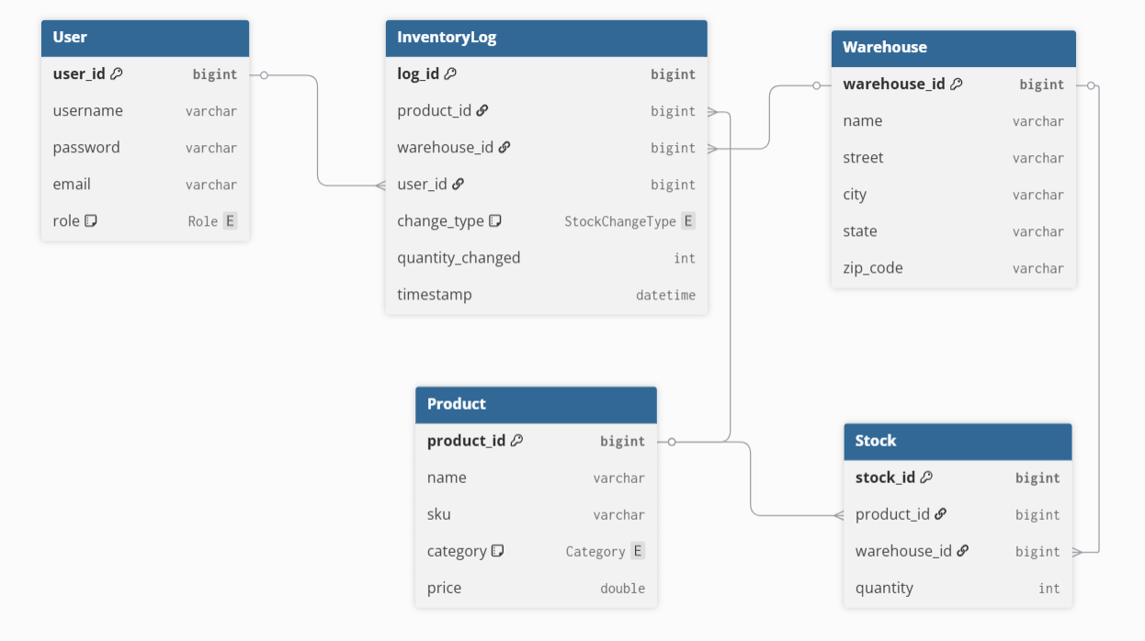
Database Structure: Entity Relationship Diagram (ERD)
The ERD visually maps the database schema, ensuring data integrity and efficient querying for all stock and product information.

Slide 10

Conclusion: Smarter Operations
The SmartWarehouse WMS provides a scalable, secure, and real-time solution to eliminate manual inventory errors and enhance operational visibility.
1
Eliminate Errors
2
Enhance Security
3
Ensure Scalability

